Slide 1
Automated Charging for a Multi-Rotor Drone
Brian Chung
Chase Crane
Dimple Gandevia
Ethan Matlack (Team Lead)
Nick Olson
Dr. Daniel Roozbahani
(Faculty)
Dr. Vicki Brown
(Senior Project Coordinator)

Slide 2
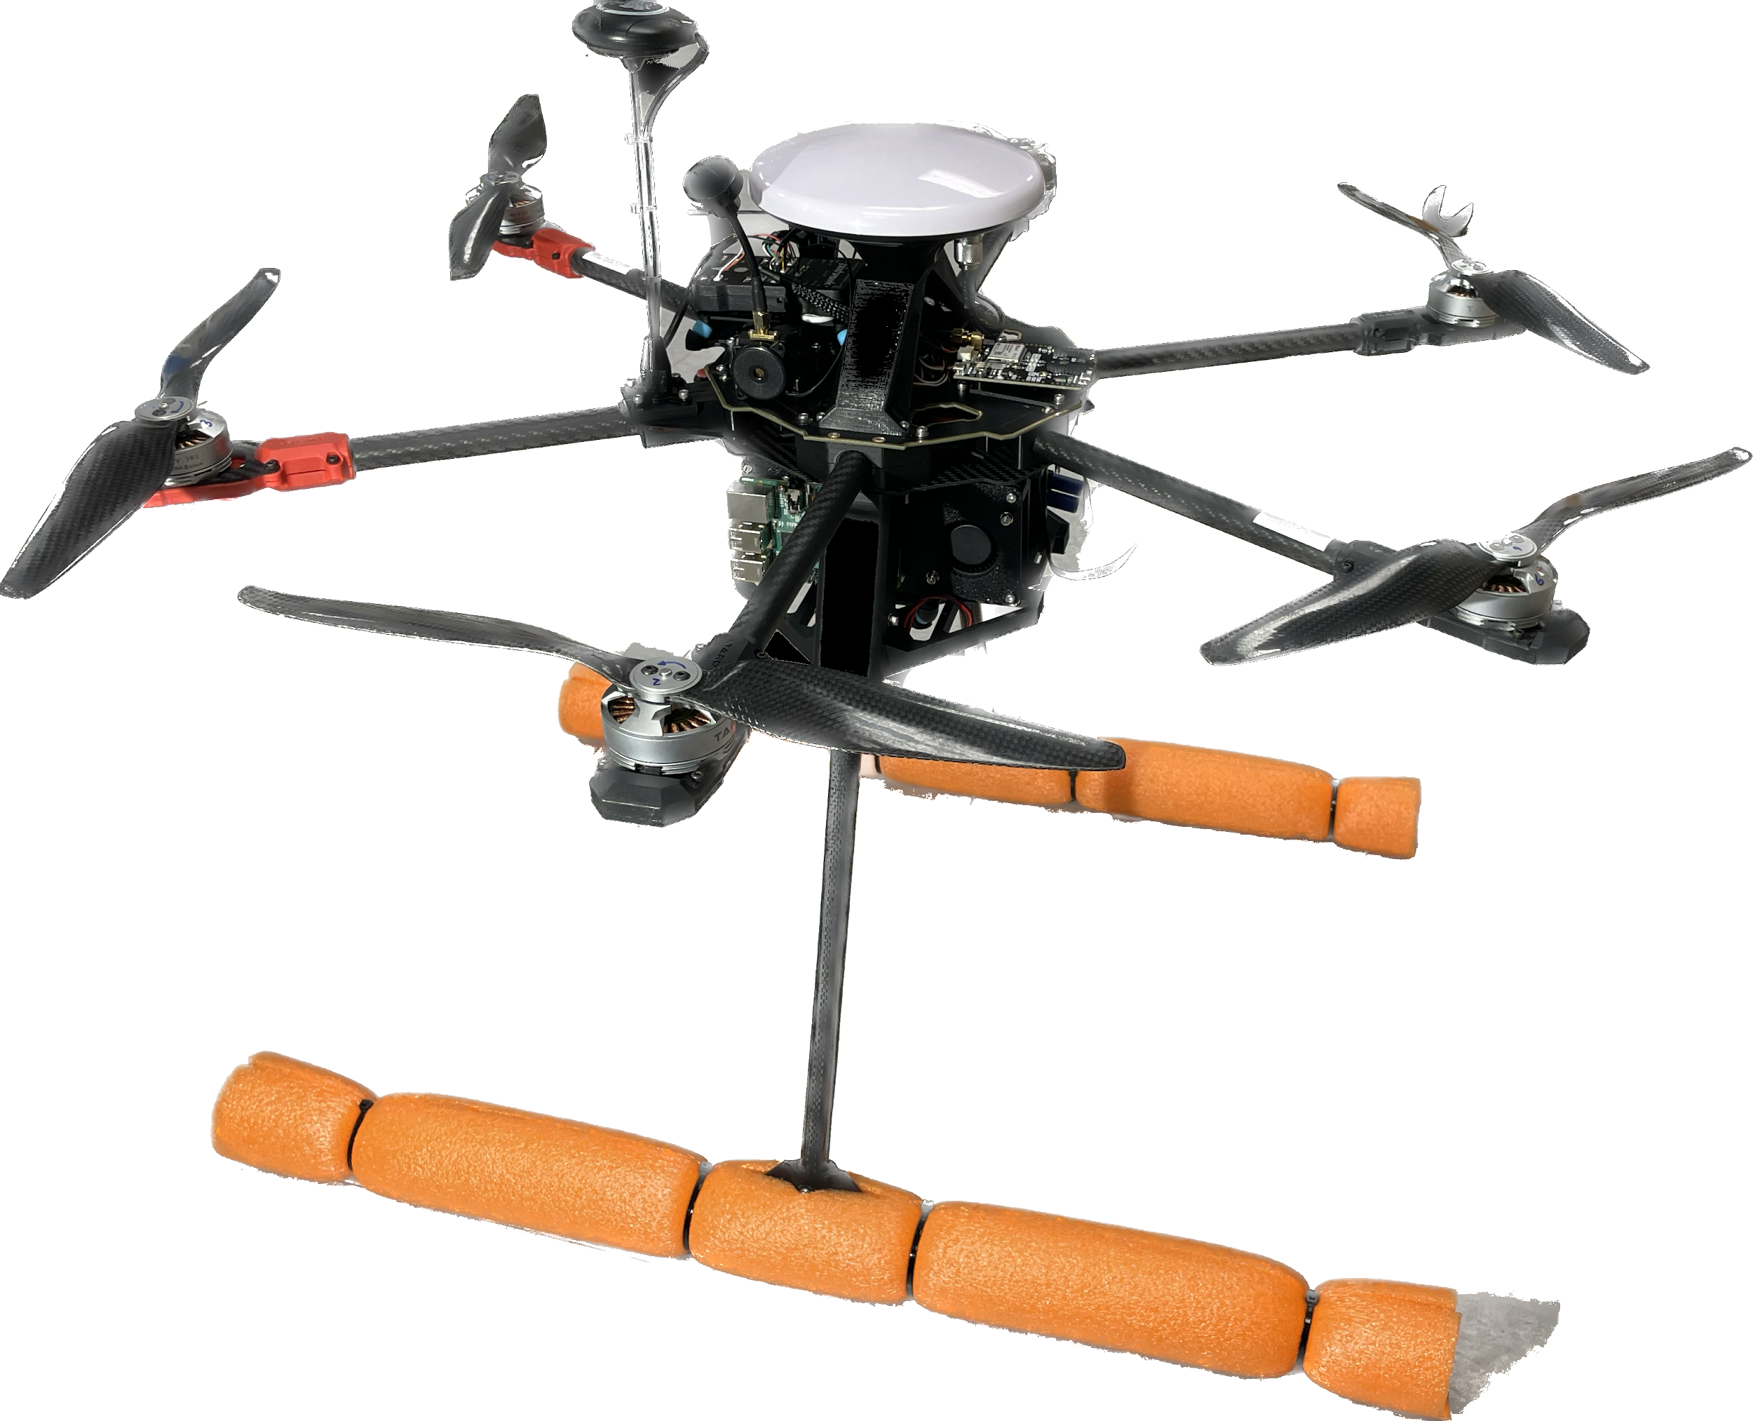
Project Summary
Scope
Design and Develop:
Autonomous Multi-rotor drone
Charging station
Onboard charging PCB
Vision-based program for landing
Notes:
Chase

Slide 3
Project Summary
Schedule
Milestone | Due Date | % Done
Project Initiation | Nov 21 | 100%
Project Research - Drone and Charging Station | Jan 12 | 100%
Development Drone Charging Station Vision Software | Mar 3 | 67% 90% 75% 40%
Flight Testing | Mar 17 | 98%
Data Analysis | Mar 17 | 39%
Final Presentation | Apr 24 | 0%
Closeout | May 9 | 0%
Notes:
Dimple.
Development - almost done, PCB design for charging station, A little behind on vision. Add more
Flight Testing and Data Analysis - Testing the landing, and hardware. Calculating battery lvl. Automated Charging

Slide 4
Project Summary
Budget Review
Spent 96.4% of $1801.20, leaving $64.85.
Over-budget on Frame and Sensors by $89.
Under-budget on Charging and General Electronics.
Expecting another $60 of spend.
Notes:
Ethan

Slide 5
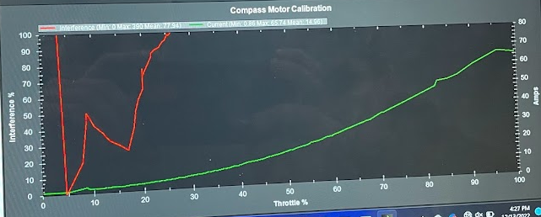
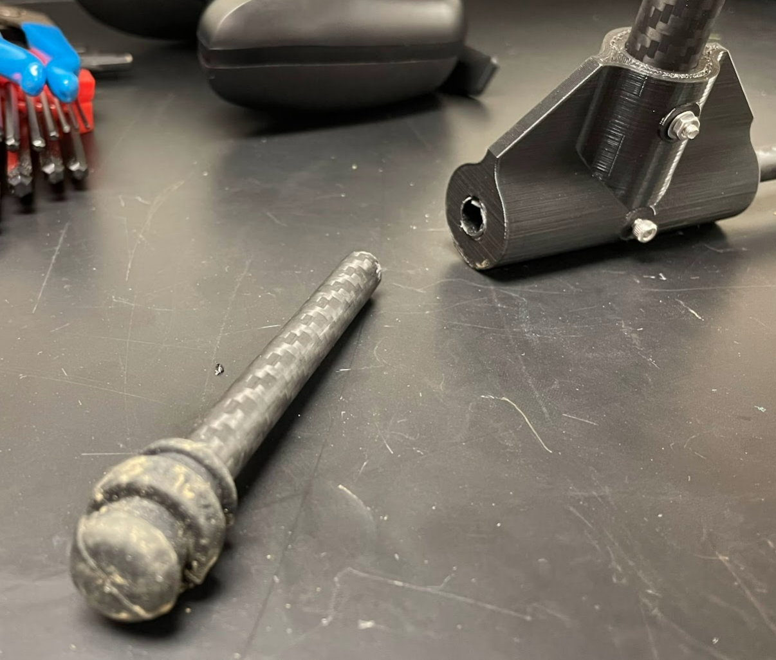
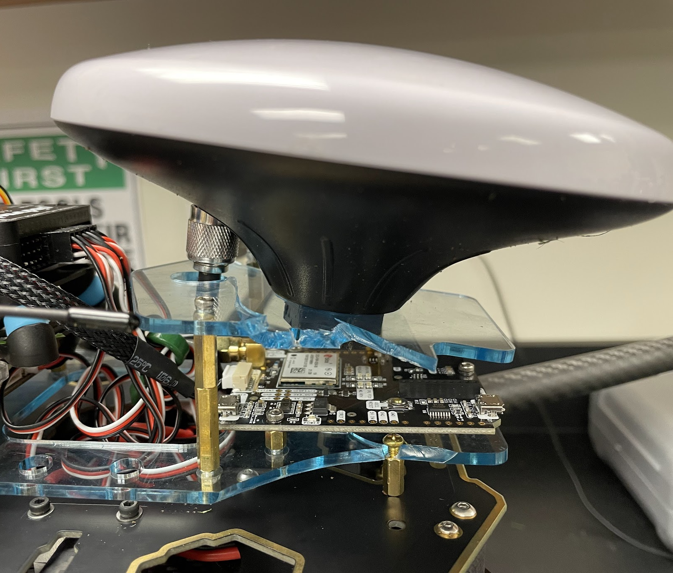
Issues
…and Risks
Magnetic interference from power distribution board
Broken parts from hard landings
Designing a custom on-board charging PCB
Budget will be very tight
We have minimal spare parts
Vision algorithm may be more complex than we anticipated
Throttle % vs Magnetic Interference
Notes:
Nick
Issues: Change in landing leg assembly, Throttle vs Magnetic Interference analysis done after initial crash
Vision: The difficulties we are facing with the vision side of this project is that it is difficult to center the drone in respect to the charging station in the correct orientation. In case there is a question: Orientation matters cause we need to match up the positive and negative leads
Charging: must make custom PCB to allow charging of the drone - unable to purchase one without extremely high costs

Slide 6
Milestone Review
by subsystem
Flight
Flight tests
Manual
Assisted
Full-auto
Auto-landing
Construction of drone
Charging
Calculating battery status
Construction of charging station
Vision
Developing a vision algorithm
Communicating over MAVlink w/ drone
Successful landing procedure
Notes:
Brian

Slide 7
Questions?
1st Full-auto flight (death by magnetic interference)
Peaceful auto-landing in sustained over 10mph winds

